Slide 1
Lecture 23
Test of Goodness of Fit
Contingency Tables

Slide 2
Test of Goodness-of-fit
Example: Scott Marketing Research firm
Over the past year market shares have stabilized, with 30% for company A, 50% for company B, 20% for company C.
Recently company C has developed a “new and improved” product that will replace its current entry in the market. Managers of company C have asked Scott firm to determine whether the new product will cause a shift in the market shares of the three competitors.

Slide 3
Scott firm conducted a survey with 200 responses. The results are:
  A 48
  B 98
  C 54
Is there any change in market shares?

Slide 4
Goodness-of-fit Test
H₀: The population follows a multinomial distribution with P_{A}=0.30 P_{B}=0.50 P_{C}=0.20；
H1: The population does not follow a multinomial distribution with P_{A}=0.30 P_{B}=0.50 P_{C}=0.20.
Basic idea：
if H₀ is true, the difference between the observed frequencies and expected frequencies should not be large.

Slide 5
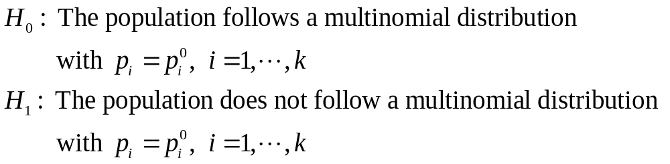
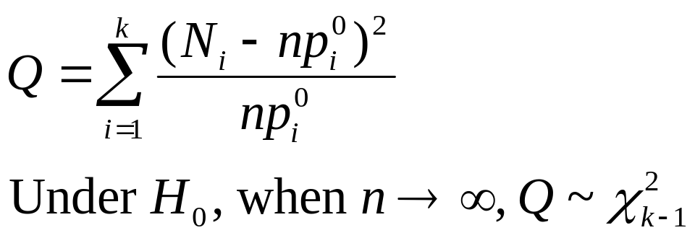



Sampling Distribution under H0
: the number of categories.
: the sample size.
: the observed counts for category i.

Slide 6
Rule of five
The test statistic used to perform the test is only approximately Chi-squared distributed.
For the approximation to apply, the expected cell frequency has to be at least 5.
If the expected frequency in a cell is less than 5, combine it with other cells.

Slide 7
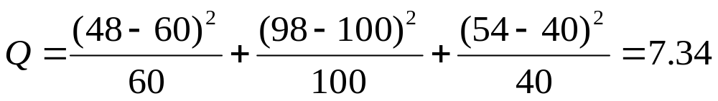

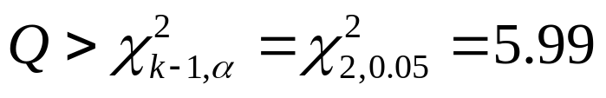

Calculations: Scott Marketing Research firm
Assumed Observed Expected
Proportion Frequency Frequency
Company A 0.3 48 60
Company B 0.5 98 100
Company C 0.2 54 40
Total 200 200
Using α= 0.05，rejection region is
Any change in market shares？
Yes!
5.99

Slide 8
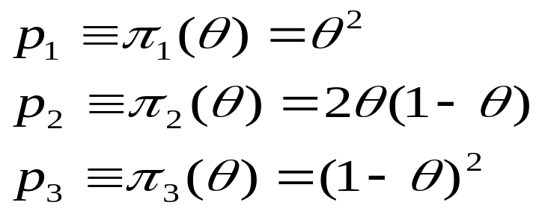
Genetics Problem
Each individual in a given population must have one of three possible genotypes, and it is assumed that the probabilities p1, p2 and p3 of the three genotypes can be represented in the following form:
A random sample is taken from the population, and the statistician must test the following hypotheses:
H₀: There exists a value of θ in (0,1) such that pi=πi(θ) for i=1,…,3,
H₁: The hypothesis H₀ is not true.

Slide 9

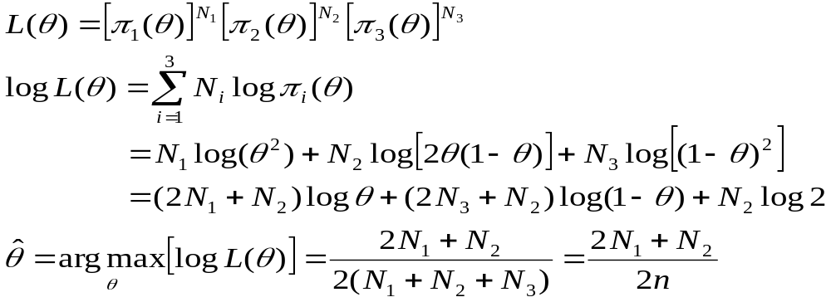
Let denote the M.L.E. of the parameter based on the observed numbers N1,…,N3, i.e.

Slide 10
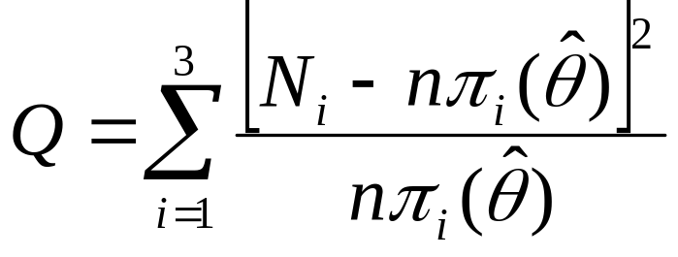


The statistic Q can be found by:
R. A. Fisher (1924) showed that if the null hypothesis is true and certain regularity conditions are satisfied, then the d.f. of Q converges to the d.f. of as the sample size where s is the number of parameters estimated (s=1 in the genetic example).

Slide 11
Contingency Tables
Alber’s Brewery manufactures and distributes three types of beer: light, regular, and dark. In an analysis of the market segments for the three beers, the firm’s market research group has raised the question of whether the preferences for the three beers differ among male and female beer drinkers. If the preference depends on the gender of the beer drinker, the firm will tailor its promotions to different target markets.

Slide 12
H0: Beer preference is independent of the gender of the beer drinker.
H1: Beer preference is not independent of the gender of the beer drinker.
Sample results:
 | Beer Preference Light Regular Dark | Total
Sex Male Female | 20 40 20 30 30 10 | 80 70
Total | 50 70 30 | 150

Slide 13
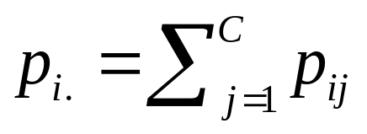

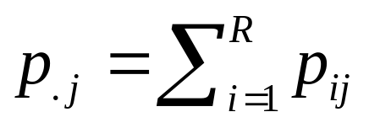
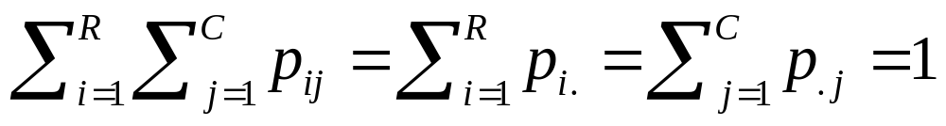
R rows and C columns.
pij: the probability that an individual selected at random from a given population will be classified in the ith row and the jth column of the table.
pi.: the marginal probability that the individual will be classified in the ith row of the table.
p.j: the marginal probability that the individual will be classified in the jth column of the table.

Slide 14
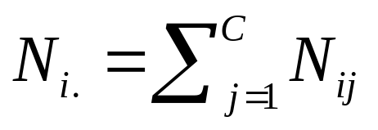
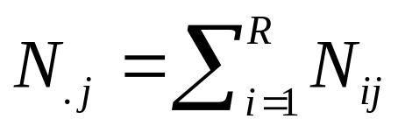
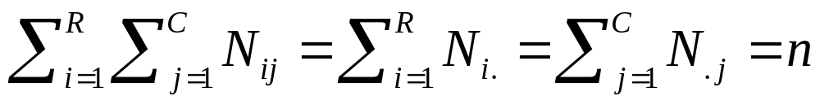
Nij: the number of individuals who are classified in the ith row and the jth column of the table.
Ni.: the number of individuals who are classified in the ith row of the table.
N.j: the number of individuals who are classified in the jth column of the table.

Slide 15

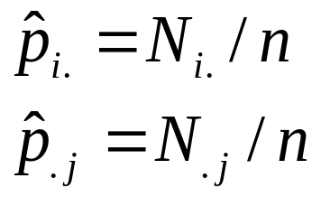
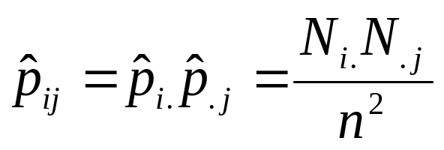
The Test of Independence
H0: pij=pi.p.j for i=1,…,R and j=1,…,C
H1: The hypothesis H0 is not true.
Notice that under the null hypothesis, only pi. and p.j need to be estimated, and the number of such parameters is (R-1)+(C-1)=R+C-2.
Based on the observed counts,
Under H0,

Slide 16
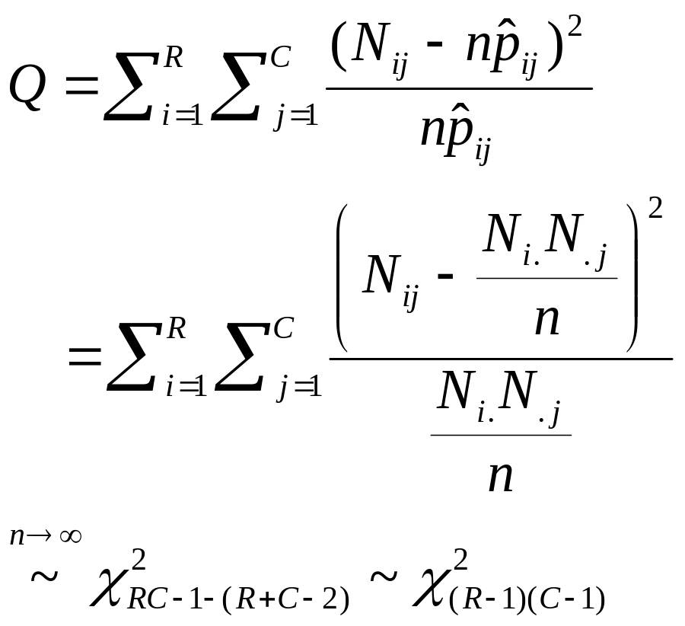
Under H0,

Slide 17
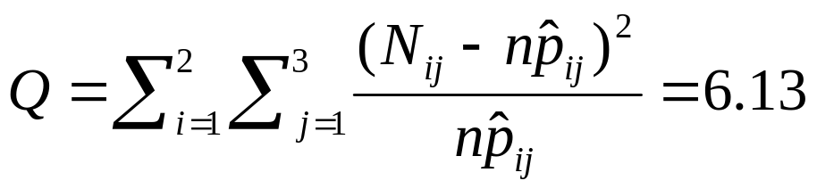
The Beer Example
Expected Frequency:
 | Beer Preference Light Regular Dark | Total
Sex Male Female | 80*50/150=26.67 80*70/150=37.33 80*30/150=16.00 70*50/150=23.33 70*70/150=32.67 70*30/150=14.00 | 80 70
Total | 50 70 30 | 150

Slide 18
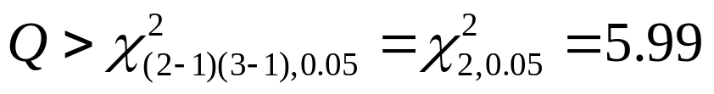
When α = 0.05, the rejection region is
So we reject the null hypothesis and conclude beer preferences is not independent of the sex of the beer drinker.

Slide 19
Example: Montana Outlook Poll
The Bureau of Business and Economic Research at the University of Montana conducted a poll of opinions of Montana residents in May 1992. Participants were asked about their income range and whether their personal financial status was worse, the same, or better than one year ago.
Income Range | Personal Financial Status Worse Same Better | Total
Under $20,000 $20,000-$35,000 Over $35,000 | 20 15 12 24 27 32 14 22 23 | 47 83 59
Total | 58 64 67 | 189

Slide 20
Example Continued
Test the null hypothesis that the income is independent of opinion on personal financial status.
Expected cell counts:
Income Range | Personal Financial Status Worse Same Better | Total
Under $20,000 $20,000-$35,000 Over $35,000 | 47*58/189=14.42 47*64/189=15.92 47*67/189=16.66 83*58/189=25.47 83*64/189=28.11 83*67/189=29.42 59*58/189=18.11 59*64/189=19.98 59*67/189=20.92 | 47 83 59
Total | 58 64 67 | 189

Slide 21
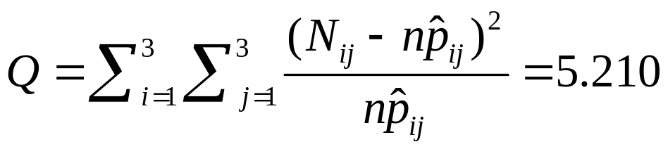
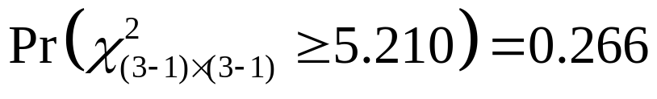
Example Continued
The test statistic is
The associated p-value is

